Slide 1

Hands-On With Monte Carlo Simulations
Mohammad Soroush Barhaghi†, Younes Nejahi‡, Loren Schwiebert‡, and Jeffrey Potoff†
† Department of Chemical Engineering & Materials Science, College of Engineering,
‡ Department of Computer Science, College of Engineering, Wayne State University, Detroit, MI,
USA 48202
Notes:
1- MC simulation engine
2- Developed by potoff group & schwibert
3- Developed for running on CPU and GPU
4- CPU system size < 10,000
5- GPU system size > 10,000

Slide 2
Tutorial files
On GitHub
Git clone https://github.com/ GOMC-WSU /Workshop.git
Website https://github.com/GOMC-WSU/Workshop
To run example: change the directory to ~/GOMC-Workshop/

Slide 3
Overview
Grand canonical Monte Carlo simulation
Adsorption of Ar and CO₂ in IRMOF-1
System setup for adsorption in porous materials, using automated HTS tools
Extract the simulation results
Canonical Monte Carlo simulation.
Solvation free energy of Ne, Ar, and Kr in cyclohexane
System setup for free energy calculation
Calculate the solvation free energy with TI and FEP estimators

Slide 4
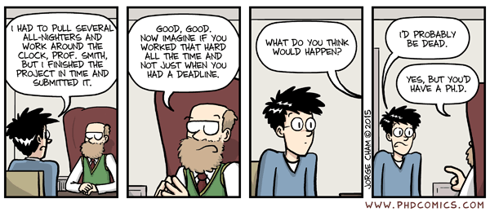
Acknowledgements
Jason Mick, Younes Nejahi, Kamel Rushaidat, Niloofar Torabi, Brock Jackman, Navendu Bhatnagar, Ganesh Kamath, Loren Schwiebert
National Science Foundation CBET-1066661, ACI-1148168, OAC-1642406
NVIDIA, Silicon Mechanics
Grid Computing at WSU

Slide 5

Introduction to GOMC

Slide 6
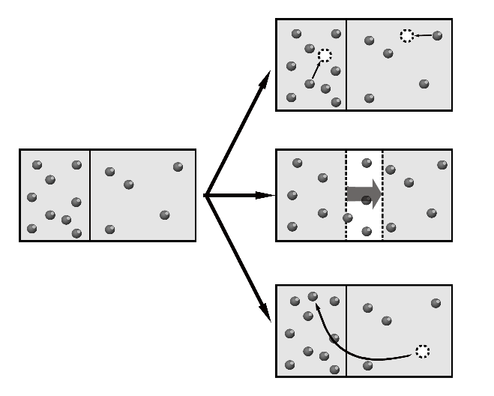
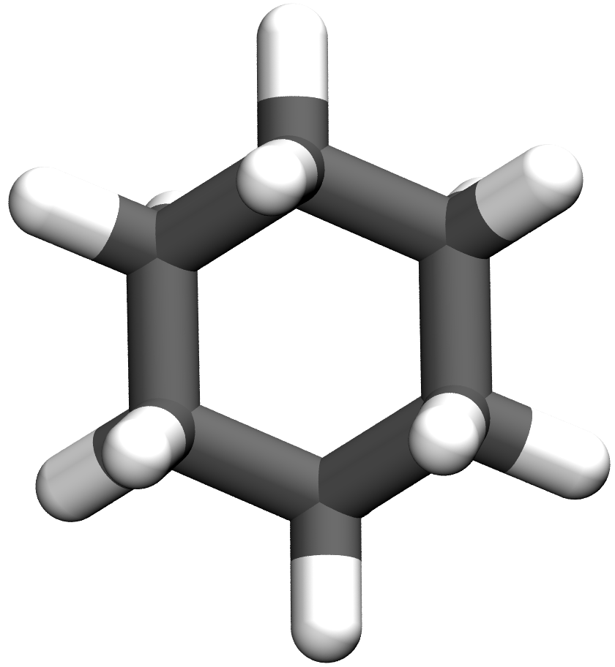
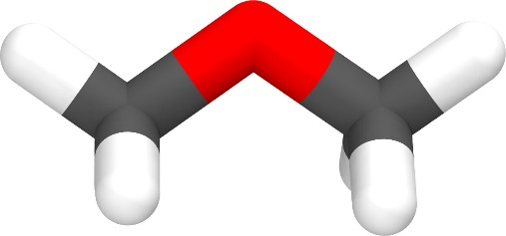
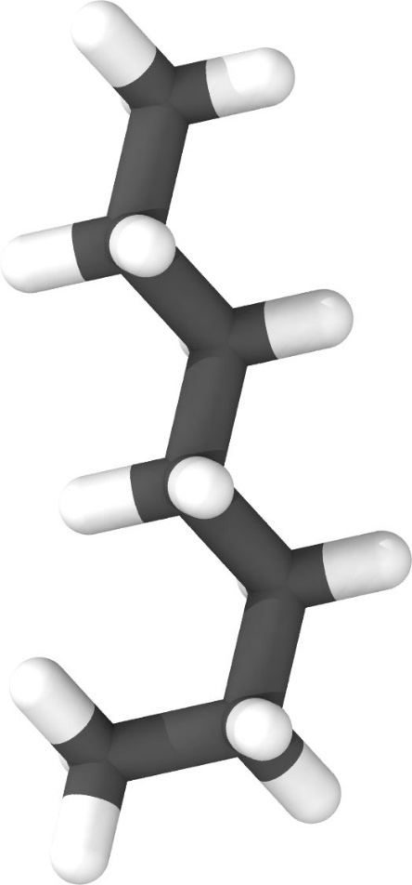
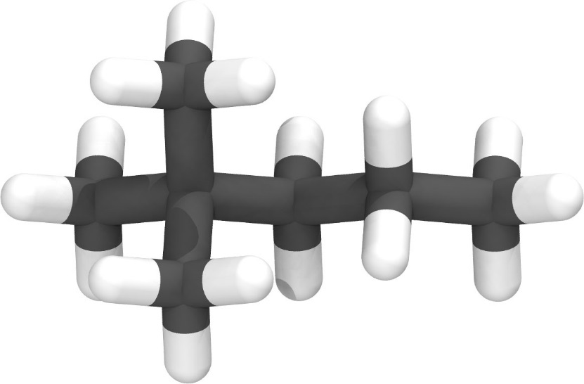

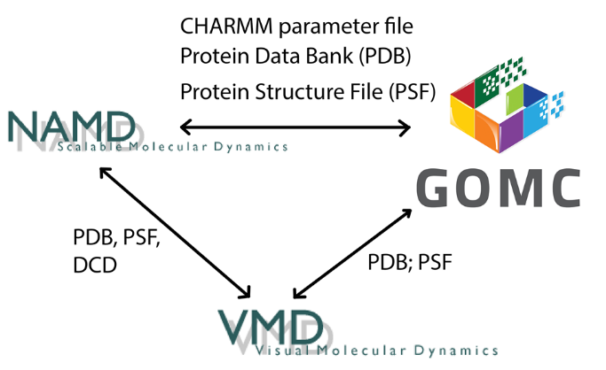
NVT, NPT, GCMC,
and GEMC
Linear, Branched, cyclic, and Polar molecules
Martini
Charmm
OPLS
Mie
Exp-6
Moves Supported:
Displacement
Rotation
Swap; Intra-swap (CD-CBMC)
Regrowth (CD-CBMC)
MEMC (inter/intra)
Multi-particle move
Free energy calculations
Volume (isotropic, anisotropic)
Parallelization
CPU
OpenMP
GPU
OpenMP + GPU

Slide 7
GOMC I/O
PDB
PDB
PSF
PSF
Log
Parameter
Block Averages
Control
GCMC: Histogram

Slide 8
GOMC I/O: Input
PDB
Coordinates of all atoms
PSF
Connectivity between atoms and partial charges.
Maps atom names to atom types
Parameter
Bonded and non-bonded parameters for all atoms,
bonds, angles and dihedrals
Control
Simulation run conditions: box size, temperature
Move ratios, parameter files, etc.

Slide 9
Single PDB file
X, Y, Z coordinates
ATOM 1 H1 SPCE 1 4.665 10.828 11.349 0.00 0.00
ATOM 2 O1 SPCE 1 4.365 11.775 11.228 0.00 0.00
ATOM 3 H2 SPCE 1 4.473 12.272 12.089 0.00 0.00
END
Atom ID
Atom name
Occupancy
residue name
Residue ID
Beta

Slide 10
Topology file
RESI SPCE 0.00
GROUP
ATOM O1 OT -0.847600 ! O1
ATOM H1 HT 0.423800 ! / \
ATOM H2 HT 0.423800 ! H1 H2
BOND O1 H1 O1 H2
PATCHING FIRS NONE LAST NONE
Defines residue name
Maps atom name to atom type
Column 3 is the partial charge
Defines bonds between pairs of atoms.
Partial charges
Atom name
Atom type

Slide 11
GOMC I/O: LOG Output
MOVE_<box number>: move statistics
ENER_<box number>: energies
STAT_<box number>: density
Data are stored in columns, making them straightforward to extract with awk.
Quantities are instantaneous values, and are defined with MTITLE, ETITLE and STITLE headers near the beginning of the log file.
Notes:
Talk about output file when Production is running!

Slide 12
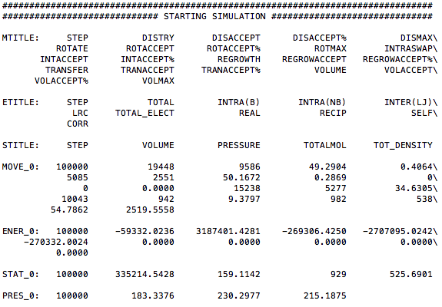
GOMC I/O: LOG Output
80

Slide 13
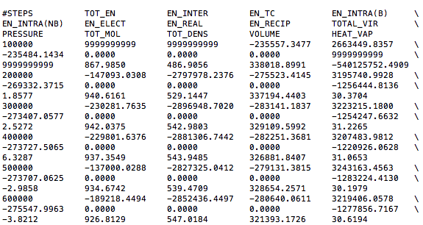
GOMC I/O: BLOCK Output

Slide 14
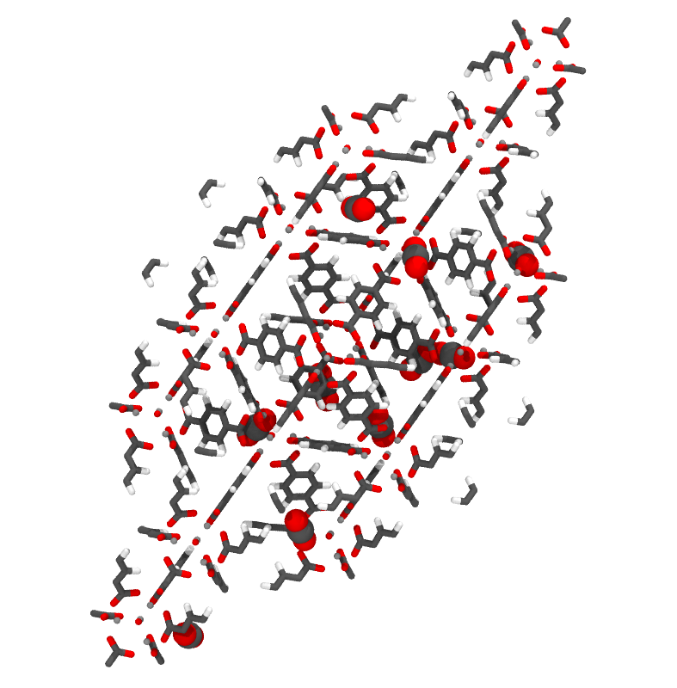
Grand Canonical Monte Carlo Example

Slide 15
Grand Canonical Monte Carlo Example
Create Topology file for adsorbate.
Build PDB and PSF files for adsorbate.
Simulation of CO₂ adsorption in IRMOF-1 at 298 K and 1.0 bar.
Calculate the number of CO₂ adsorbed.

Slide 16
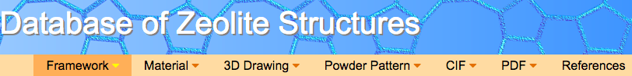

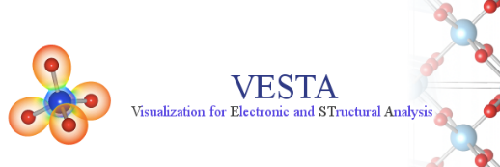
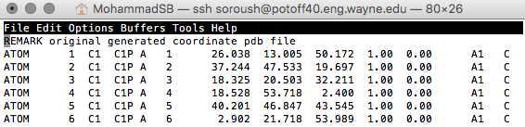
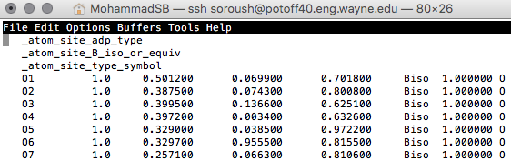
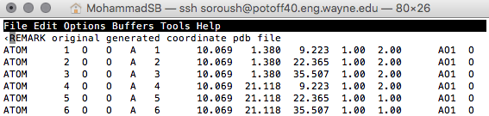
Creating PDB for adsorbent:
Beta = 0: Displace, Rotate, Intra-swap, Swap, regrowth
Beta = 1: Fix position
Beta = 2: Displace, Rotate, Intra-swap, regrowth
Beta Value
Tcl script in VMD
Notes:
Code uses the PDB values in the PDB to determine if a particular molecule should be moved or not.

Slide 17
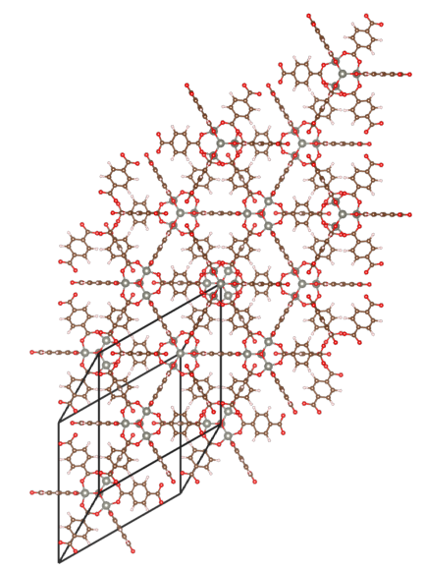
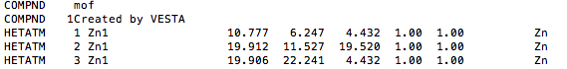
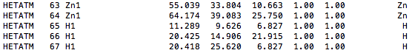
Creating PDB for adsorbent:
To generate the PDB file, each atom will be considered its own molecule. Assign resname using atom name.
Download the crystal structure.
Use VESTA to:
Extend the unit cell by factor of 2.
Remove the bonds.
Export the structure as PDB file.
: : : : : : : :

Slide 18

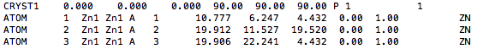
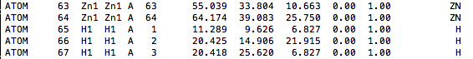
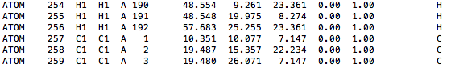
Creating PDB for adsorbent:
To generate the PDB file, each atom will be considered its own molecule. Assign resname using atom name.
Use convert script to assign resname and resid based on atom name.
vmd < ./ convert_VESTA_PDB.tcl
: : : : : : : : : : : :
: : : : : : : : : : : :

Slide 19
IRMOF-1 Topology file:
MASS 1 O 15.999 O
MASS 2 C 12.010 C
MASS 3 H 1.0079 H
MASS 4 ZN 65.3800 ZN
DEFA FIRS none LAST none
AUTOGENERATE ANGLES DIHEDRALS
RESI ZN1 1.333 ! IRMOF-1 - DFT charges
ATOM ZN1 ZN 1.333 !
PATCHING FIRS NONE LAST NONE
RESI H1 0.162 ! IRMOF-1 - DFT charges
ATOM H1 H 0.162 !
PATCHING FIRS NONE LAST NONE
RESI O1 -1.564 ! IRMOF-1 - DFT charges
ATOM O1 O -1.564 !
PATCHING FIRS NONE LAST NONE
RESI O2 -0.641 ! IRMOF-1 - DFT charges
ATOM O2 O -0.641 !
PATCHING FIRS NONE LAST NONE
RESI C1 -0.167 ! IRMOF-1 - DFT charges
ATOM C1 C -0.167 !
PATCHING FIRS NONE LAST NONE
RESI C2 0.558 ! IRMOF-1 - DFT charges
ATOM C2 C 0.558 !
PATCHING FIRS NONE LAST NONE
RESI C3 0.106 ! IRMOF-1 - DFT charges
ATOM C3 C 0.106 !
PATCHING FIRS NONE LAST NONE END

Slide 20
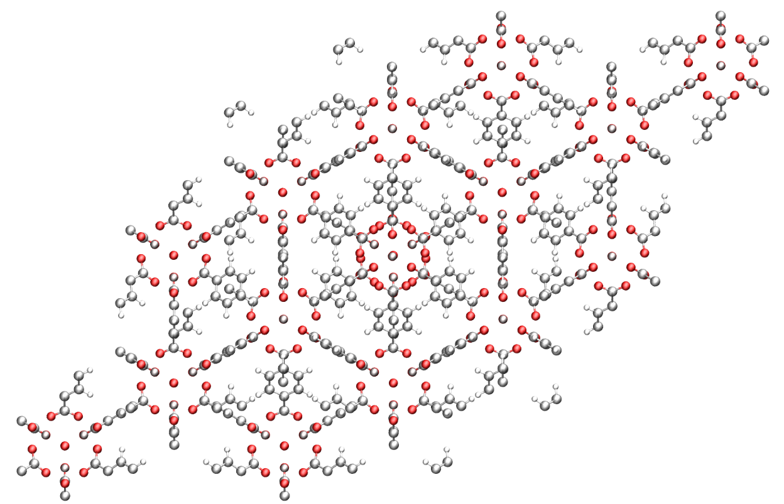
Creating PSF for adsorbent:
To generate the PSF file, separate each residue in each file and use psfgen to generate PSF file.
Use build scripts (build_EDUSIF_auto.tcl) to separate each residue type and generate PDB and PSF files.
Set beta value to 1 in PDB by using (setBeta.tcl) script.
Execute these commands:
vmd < ./build_EDUSIF_auto.tcl
vmd < ./setBeta.tcl

Slide 21
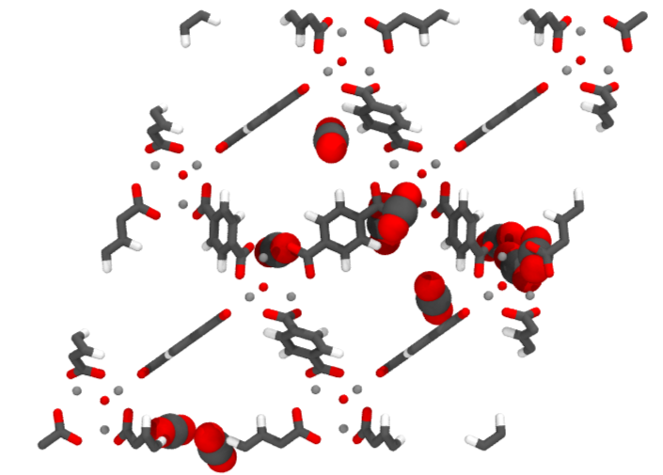
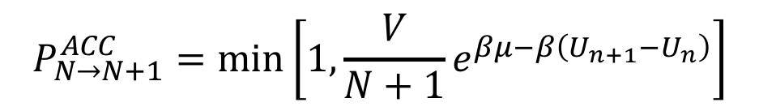
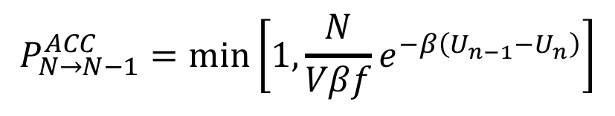
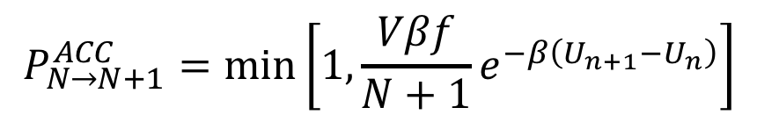
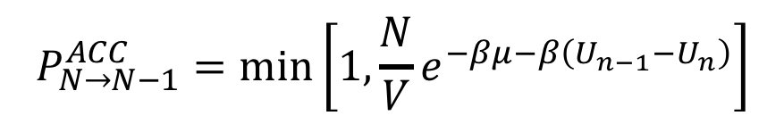
Grand Canonical Monte Carlo
Acceptance criteria for molecule swap in Grand Canonical ensemble Monte Carlo (GCMC).
Chemical Potential (K)
$$P_{N→N+1}^{ACC}=\min\left[1, {\frac{V}{N+1}e}^{βμ−β\left(U_{n+1}−U_{n}\right)}\right]$$
$$P_{N→N−1}^{ACC}=\min\left[1, {\frac{N}{V}e}^{−βμ−β\left(U_{n−1}−U_{n}\right)}\right]$$
Fugacity (bar)
$$P_{N→N+1}^{ACC}=\min\left[1, {\frac{Vβf}{N+1}e}^{−β\left(U_{n+1}−U_{n}\right)}\right]$$
$$P_{N→N−1}^{ACC}=\min\left[1, {\frac{N}{Vβf}e}^{−β\left(U_{n−1}−U_{n}\right)}\right]$$

Slide 22
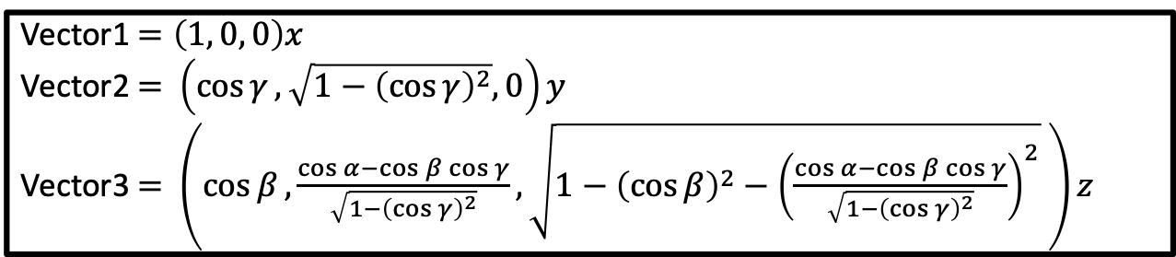
Control file: GCMC
# INPUT PDB, PSF FILES
Coordinates 0 ../build/base/IRMOF_1_BOX_0.pdb
Coordinates 1 ../build/reservoir/START_BOX_1.pdb
Structure 0 ../build/base/IRMOF_1_BOX_0.psf
Structure 1 ../build/reservoir/START_BOX_1.psf
# MOVE FREQUENCY
DisFreq 0.30
RotFreq 0.30
SwapFreq 0.40
# Chemical Potential/Fugacity
Fugacity CO2 1.0
Fugacity C1 0.0
Fugacity C2 0.0
Fugacity C3 0.0
Fugacity H1 0.0
Fugacity O1 0.0
Fugacity O2 0.0
Fugacity ZN1 0.0
# BOX DIMENSION #, X, Y, Z
CellBasisVector1 0 36.8140 0.0 0.0
CellBasisVector2 0 18.2583 31.9880 0.0
CellBasisVector3 0 18.2712 10.5596 30.1748
CellBasisVector1 1 50.00 0.00 0.00
CellBasisVector2 1 0.00 50.00 0.00
CellBasisVector3 1 0.00 00.00 50.00
# OutHistSettings
DistName dis
HistName his
RunNumber 1
RunLetter a
SampleFreq 200
Vector1$=\left(1, 0, 0\right)x$
Vector2 $=$ $\left(\cos{γ}, \sqrt{1−{\left(\cos{γ}\right)}^{2}}, 0\right)y$
Vector3 $=$ $\left(\cos{β}, \frac{\cos{α}−\cos{β\cos{γ}}}{\sqrt{1−{\left(\cos{γ}\right)}^{2}}},\sqrt{1−{\left(\cos{β}\right)}^{2}−{\left(\frac{\cos{α}−\cos{β\cos{γ}}}{\sqrt{1−{\left(\cos{γ}\right)}^{2}}}\right)}^{2}} \right)z$

Slide 23
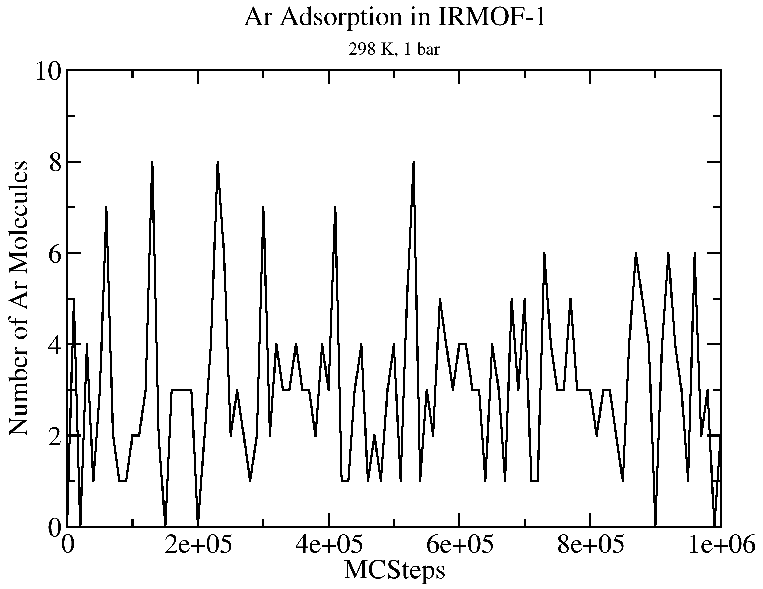
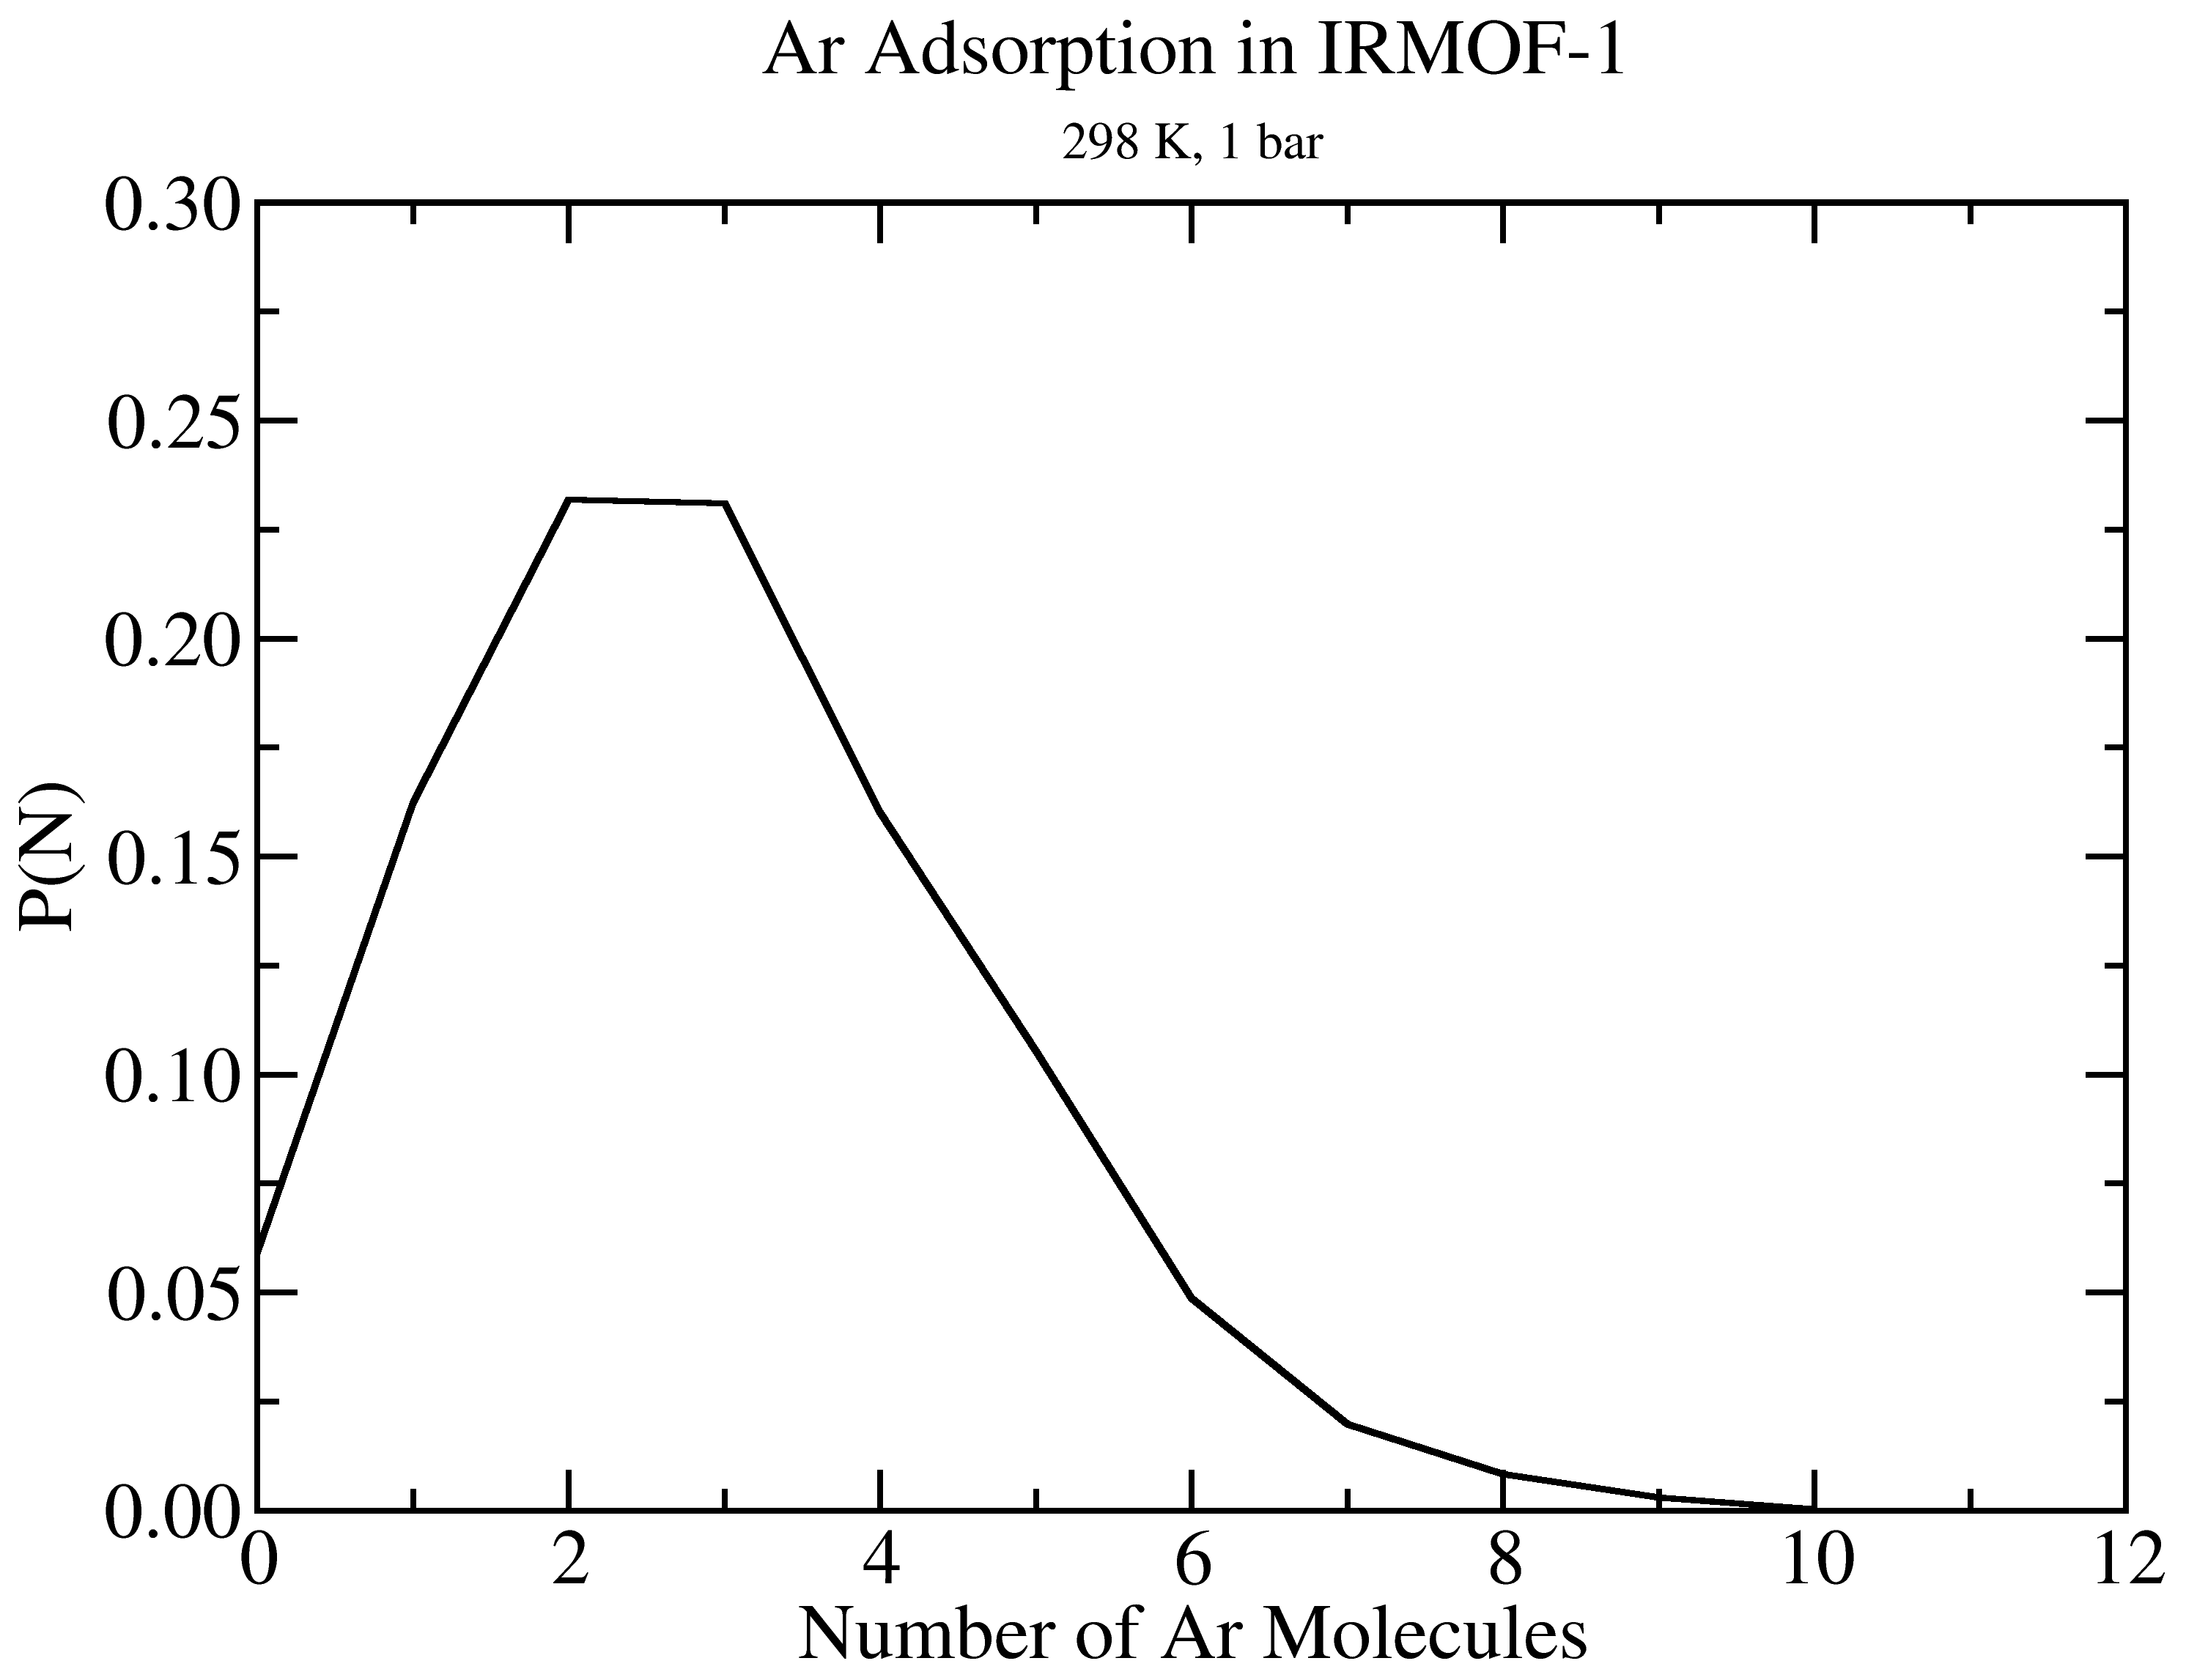
GOMC I/O: GCMC
Extract data using awk
cat output_AR.log | awk '/STAT_0/ {print $2, $3*$5}' > mol_AR_fluct.dat

Slide 24
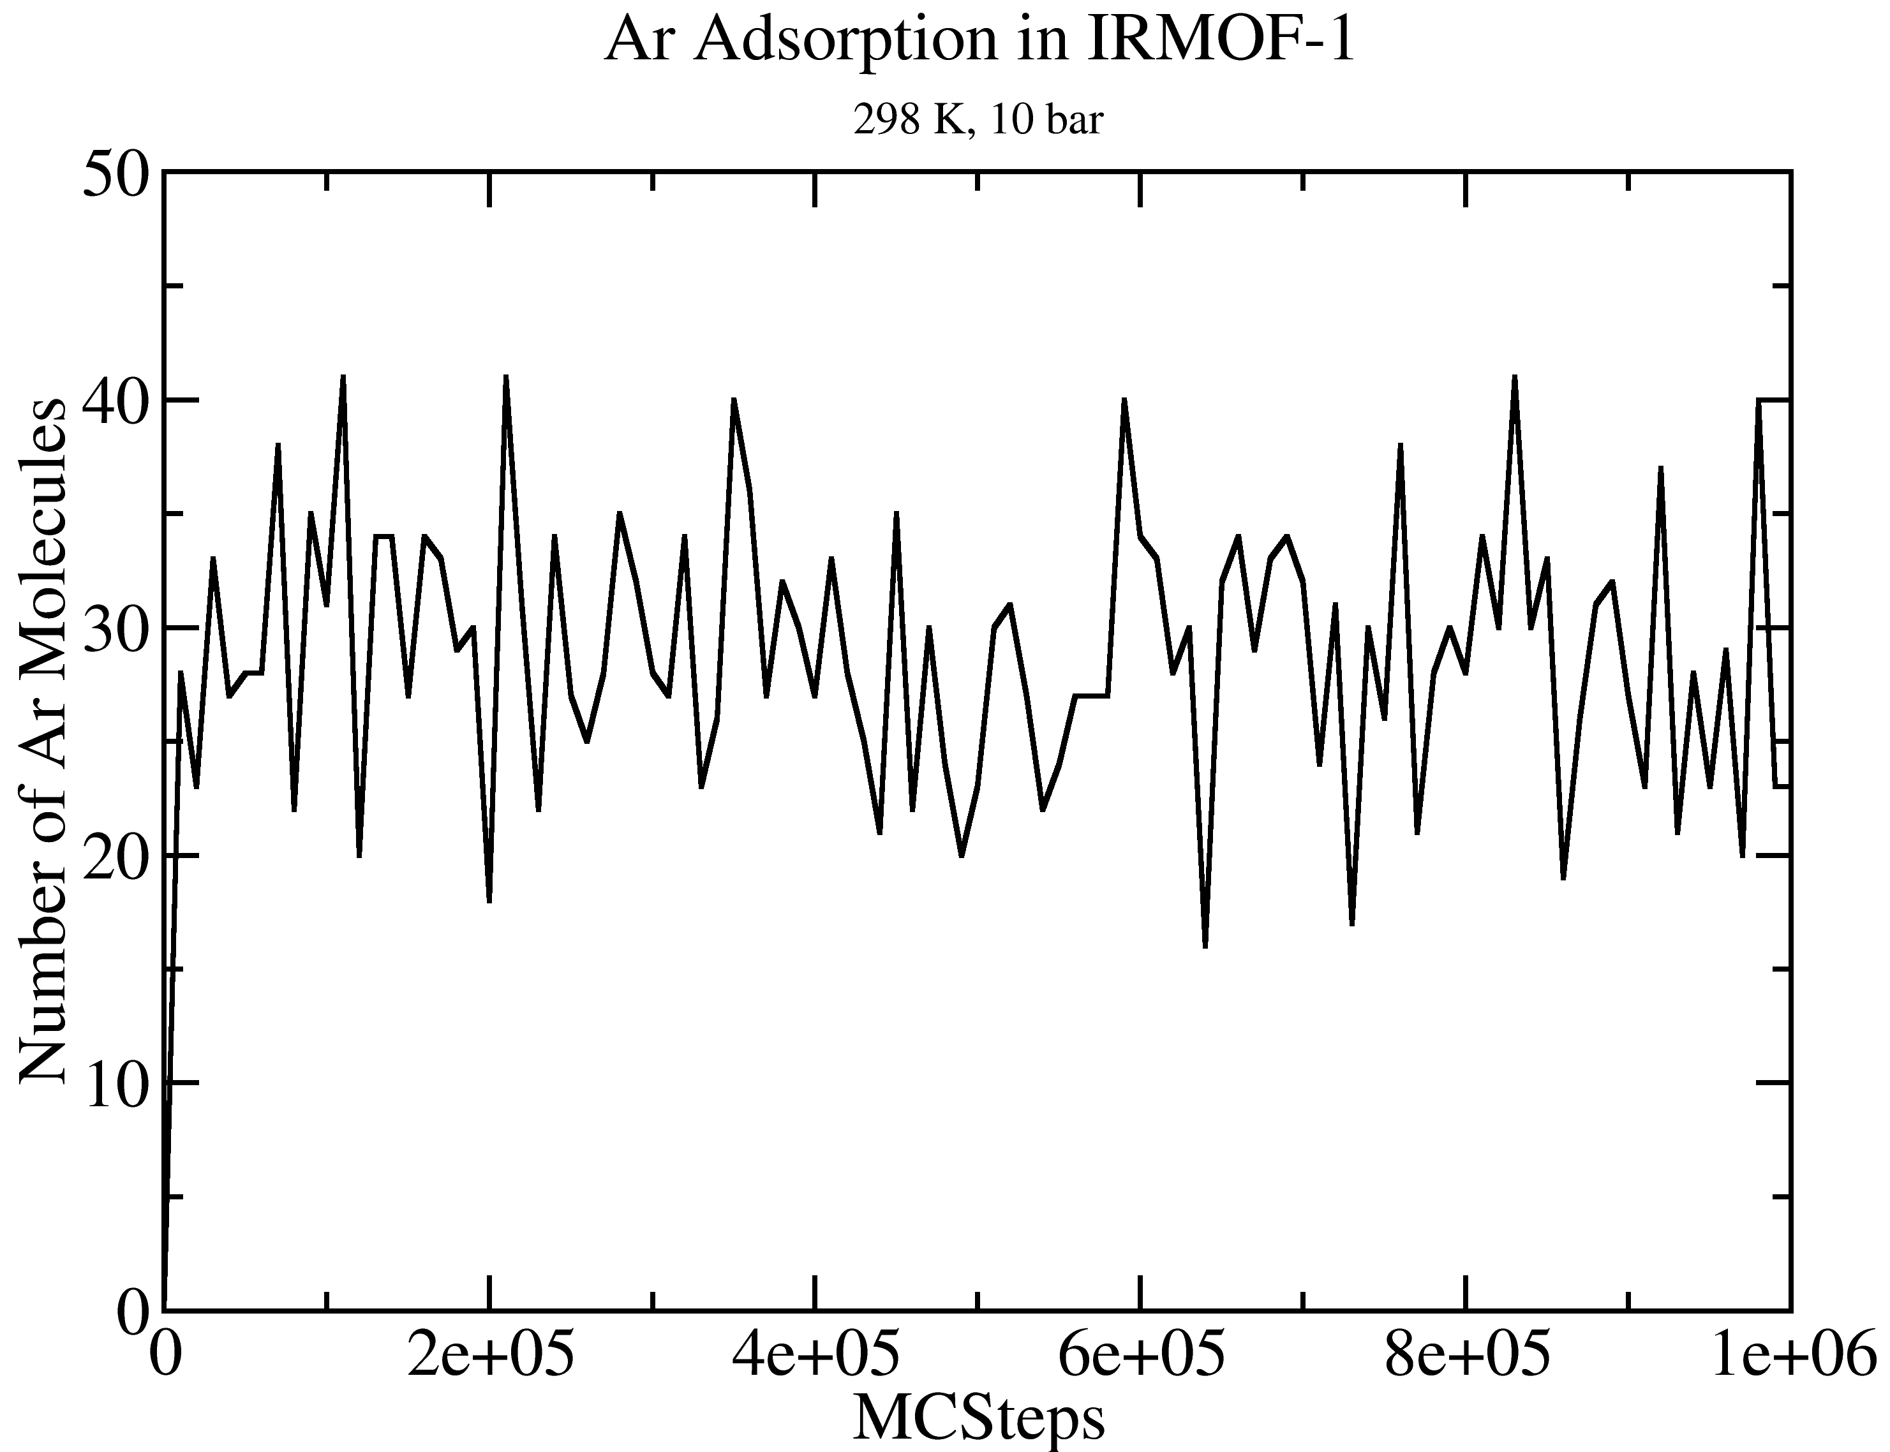
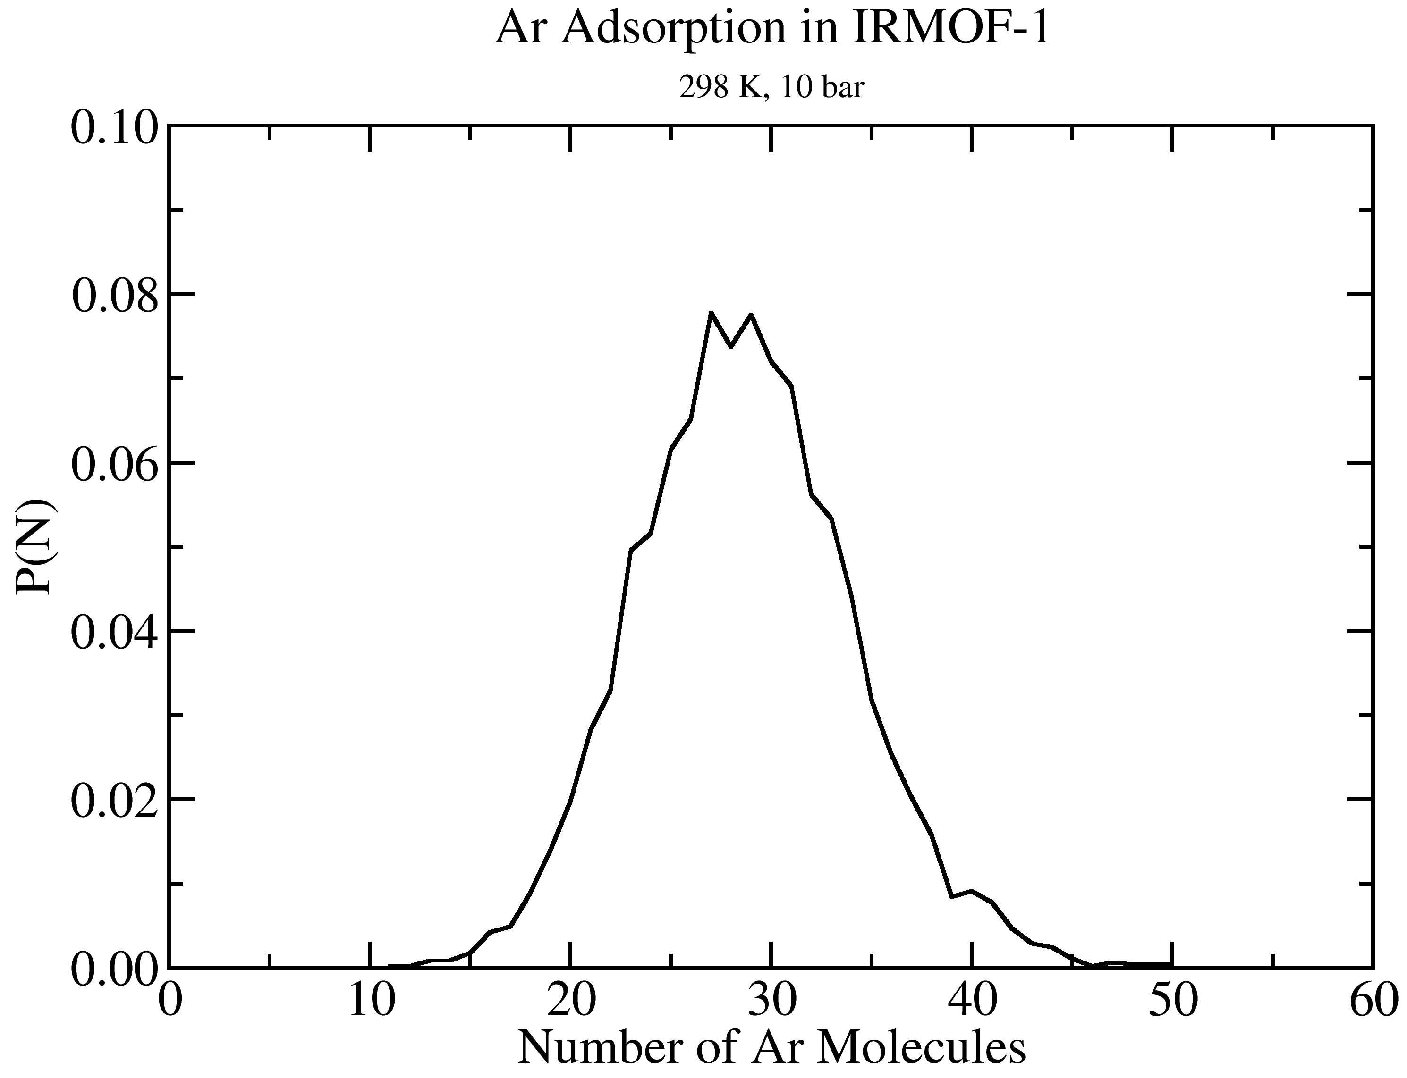
GOMC I/O: GCMC
Extract data using awk
cat output_AR.log | awk '/STAT_0/ {print $2, $3*$5}' > mol_AR_fluct.dat

Slide 25
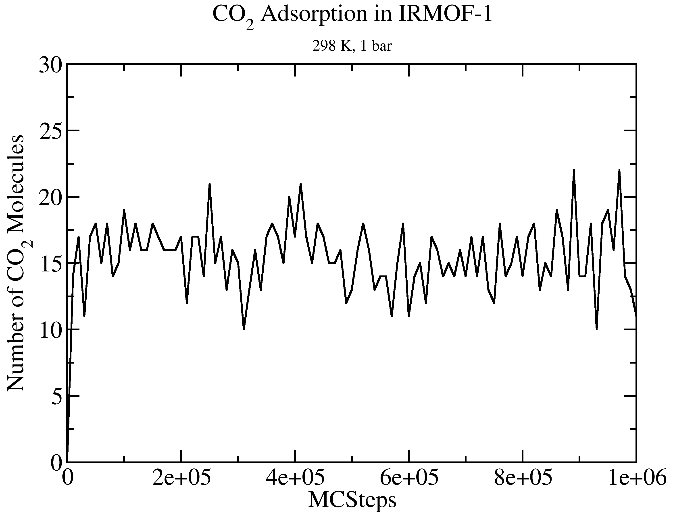
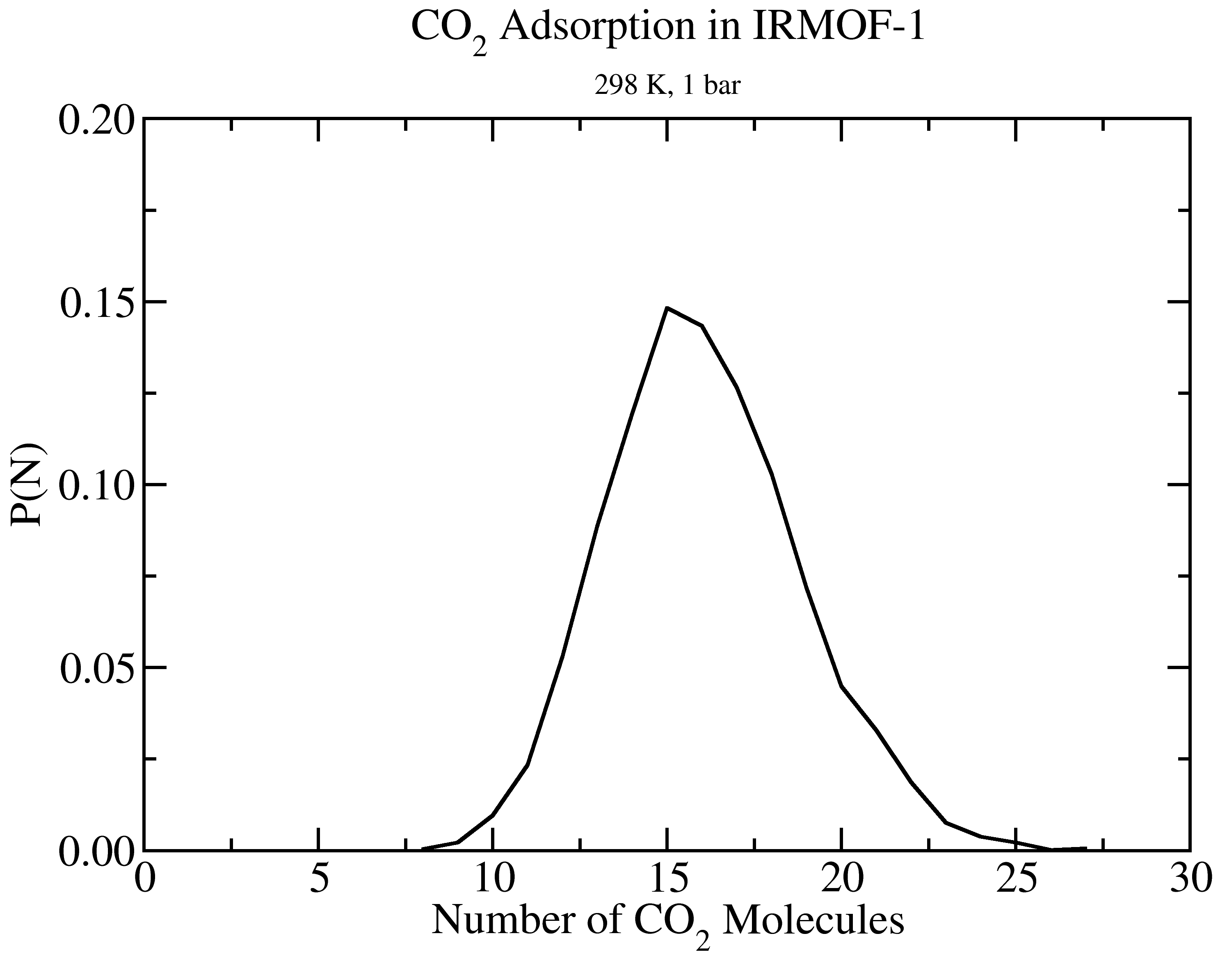
GOMC I/O: GCMC
Extract data using awk
cat output_CO2.log | awk '/STAT_0/ {print $2, $3*$5}' > mol_CO2_fluct.dat

Slide 26
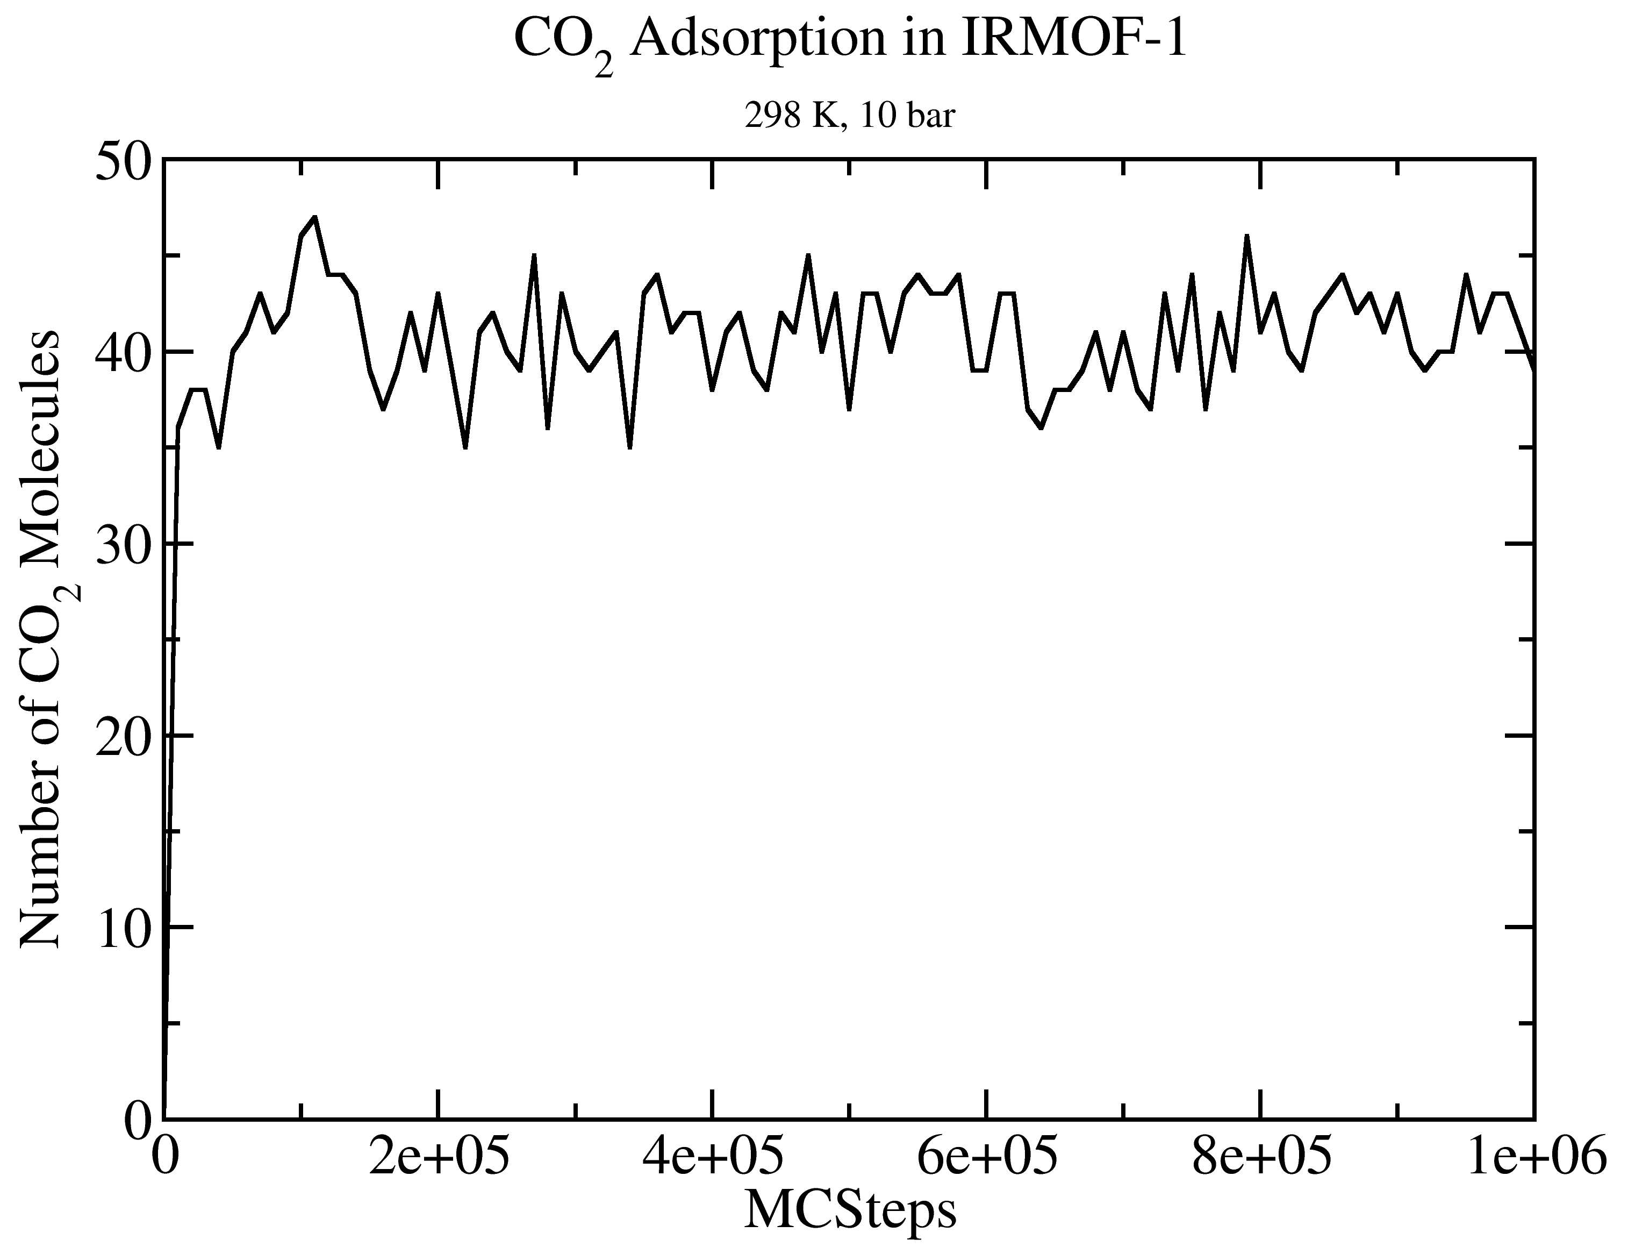
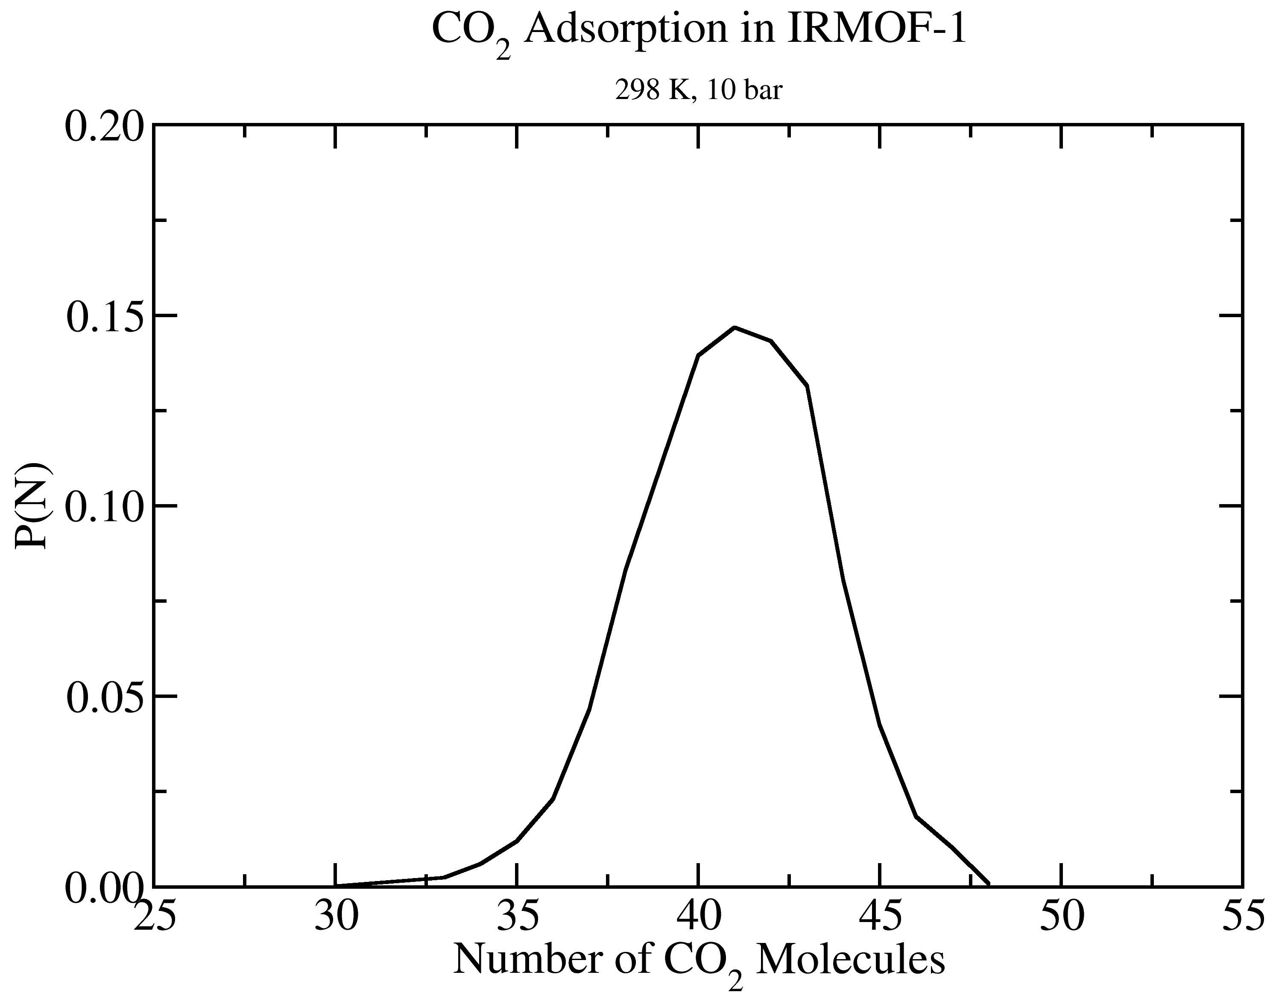
GOMC I/O: GCMC
Extract data using awk
cat output_CO2.log | awk '/STAT_0/ {print $2, $3*$5}' > mol_CO2_fluct.dat

Slide 27
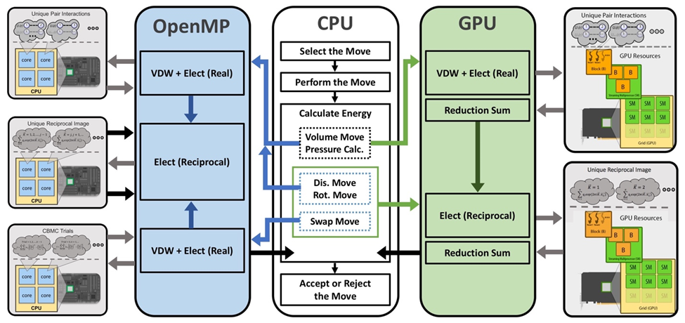
GOMC on Multicore and GPU

Slide 28
Acknowledgements
Jason Mick, Younes Nejahi, Kamel Rushaidat, Niloofar Torabi, Brock Jackman, Navendu Bhatnagar, Ganesh Kamath, Loren Schwiebert
National Science Foundation CBET-1066661, ACI-1148168, OAC-1642406
NVIDIA, Silicon Mechanics
Grid Computing at WSU

